Slide 1
Online Meeting Planner
COMP 307 Final Project
Chaohe Shi, Mark Slavsky, Philippe Sawyer

Slide 2
Plan for meeting?
Let’s go watch movie tomorrow!
Chao
Mark
Cool! I’m available after 12pm.
Philippe
Anytime before 6 in the afternoon.
Bob
3 to 7 works for me.
Carl
I am free in the morning, and 2:30 to 5:30 and 6:30 to 8:30 after noon.
Bob
Ops! Sorry I won’t be available from 4 to 5
Let’s stay at home…
Chao

Slide 3
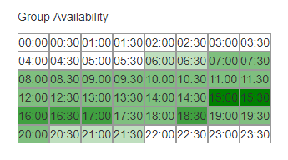
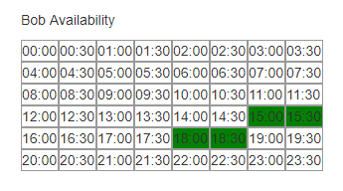
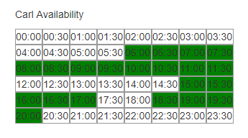
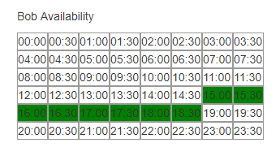
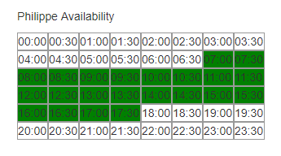
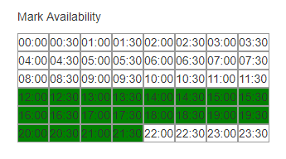
Plan for meeting?

Slide 4
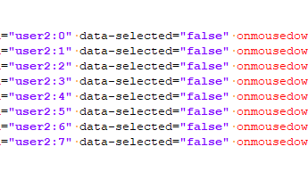
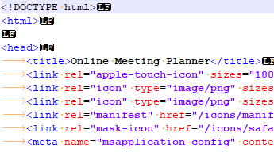
Front end
The data-* can then be used in the page's JavaScript to create a more engaging user experience (without any Ajax calls or server-side database queries).
HTML5

Slide 5
Front end
HTML5
JavaScript

Slide 6
Front end
HTML5
JavaScript
JQuery

Slide 7
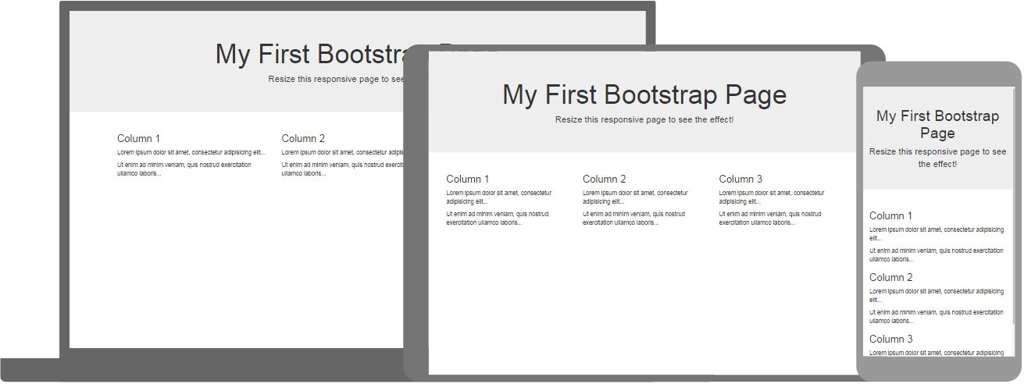
Front end
HTML5
JavaScript
JQuery
BootStrap
Free front end framework
Responsive, mobile-first web sites

Slide 8
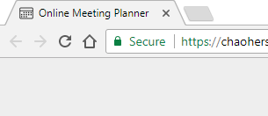
Special tech
Security
Let's Encrypt - Free SSL/TLS Certificates
. htaccess Redirects

Slide 9

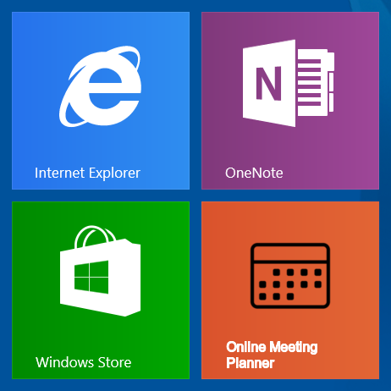
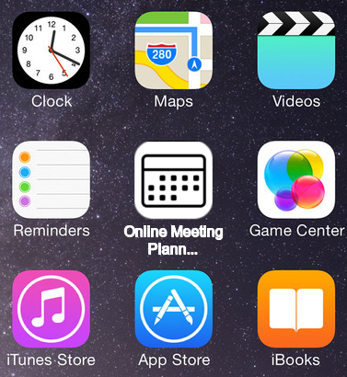
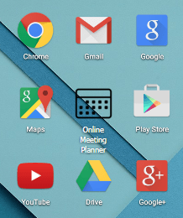
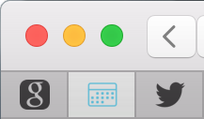
Special tech
Security
Favicon
- for all!

Slide 10
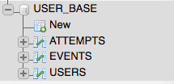
Back end
SQL
PHP

Slide 11
What we learned
Positive: Hosting website, experience with different technologies, version control
Negative: Time management

Slide 12
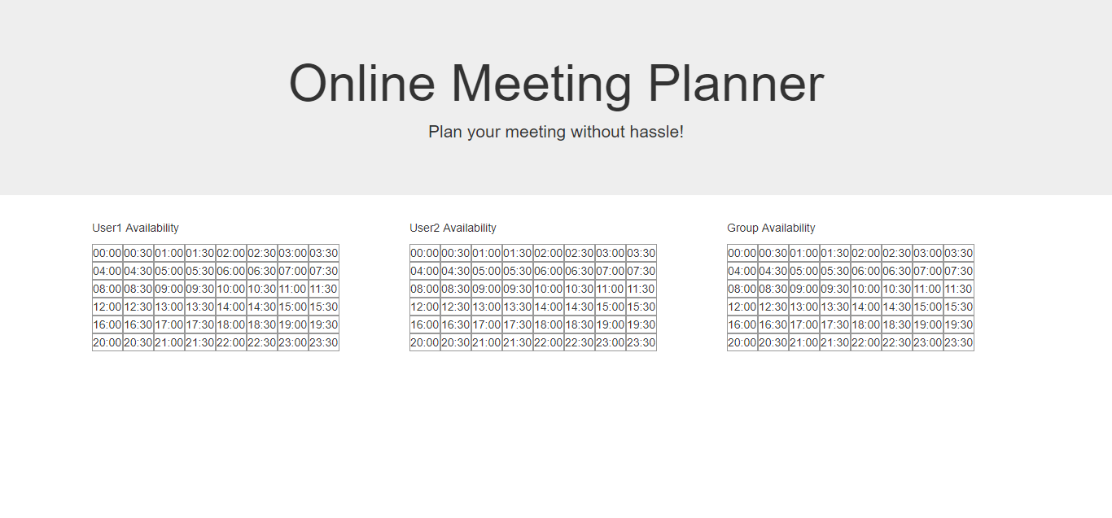
Demo

Slide 13
Questions?

Slide 14
Thank you!

